Slide 1
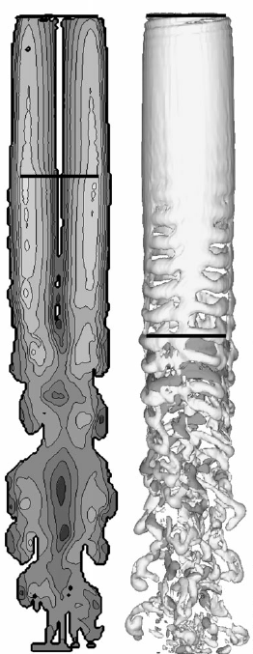
Development of a Parallelizable Implementation of the Vorticity Transport Model for Vortex Dominated Flows
Josh Bevan, 22.581 Adv. Fluids, Fall 2013

Slide 2
Abstract
Many physical systems strongly influenced by vortex flows
- helicopters
- wind turbine farms.
Important to resolve the vortex flows, but challenging computationally
Accurate but practical simulation tools: a combination of vortex advection modeling with practical parallelization
The Vorticity Transport Model (VTM) modifies the Navier-Stokes equation and solves for the unsteady transport equation for vorticity.
- discretizes and solves this equation along with the Biot-Savart relationship to conservatively advect vorticity throughout a domain.
Uses domain decomposition using an octree structure.
- octree provides for recursive grid refinement and Fast Multipole Method (FMM)
Octree domain structuring: ready-made framework for implementation of a parallelizable computational approach

Slide 3


Introduction
VTM [1] recasts the Navier-Stokes equation into vorticity-velocity form
Velocity field determined from vorticity field following Biot-Savart law [2]

Slide 4
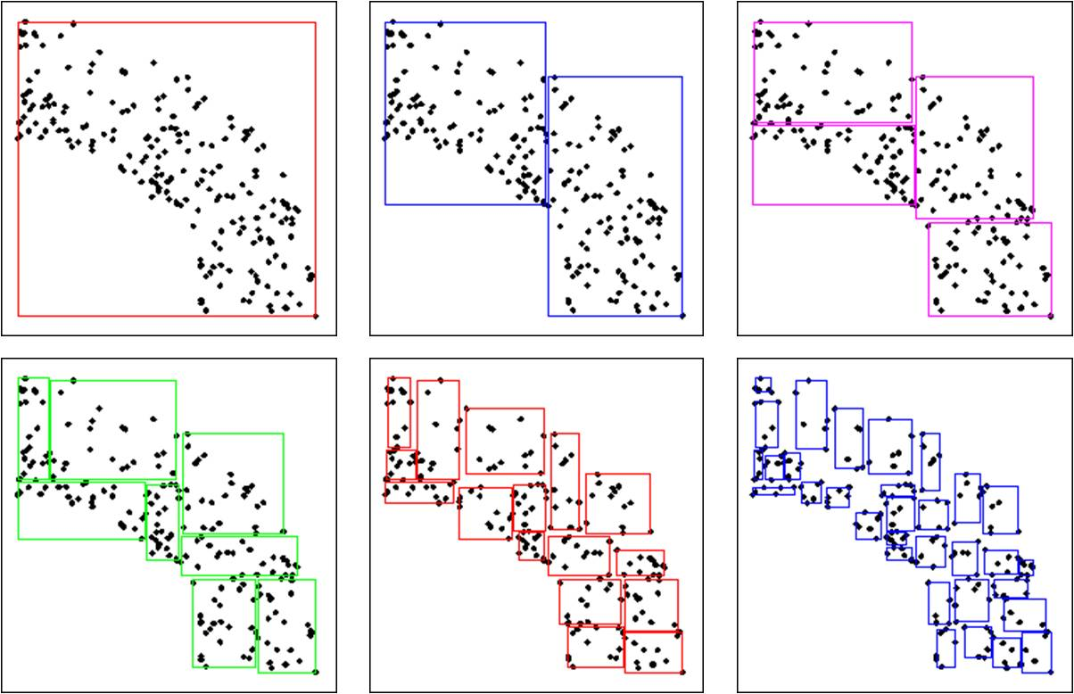
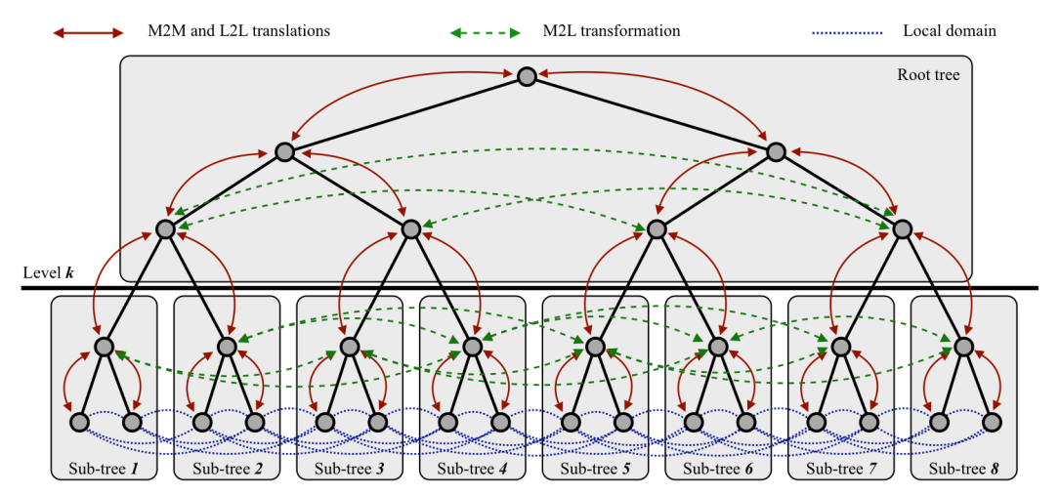
Intro, FMM
FMM solves n-body problem posed by Biot-Savart much faster than a naïve direct solution - grouping multiple long-range interactions into one approximated bulk interaction [4]
http://people.cs.uchicago.edu/~knepley/ http://www.cs.ubc.ca/~nando/

Slide 5
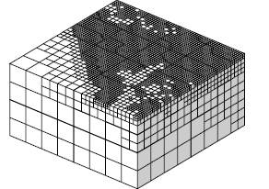
Technical Approach
VTM defines domain including entirety of vorticity produced and advected
This avoids dealing with boundary conditions on the domain.
As vorticity evolves domain could either be adaptively expanded, or an a priori estimate could be used to specify a static domain size that will satisfactorily enclose the system for scope of time simulated
In areas where vorticity needs to be resolved the octree is refined, while in areas free of vorticity the octree is left unrefined
Adaptive grid refinement using an octree structure. [7]

Slide 6
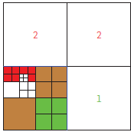
Tech. Approach, cont.
Important component of efficient parallelism is domain decomposition that minimizes inter-process communication
domain must be decomposed
then partially reconstructed with ghost octants for non-local interactions during an upward traversal of the octree during calculation [5]
Critical part of the implementation of the FMM for the VTM will require processor balancing to prevent local resource bottlenecks from slowing global execution.
Some work has been done addressing this [6] by assigning computation weights to particular leaves and then repartioning to equalize the predicted load.
A robust implementation will seek to both minimize communication while optimizing load balancing.
Domain decomposition and inter-process communication amongst "ghost" octants. [5]

Slide 7
Tech. Approach, cont.
Project primarily consists of three phases.
basic algorithmic development to create potential parallel solutions to the individual pieces of the VTM. Prototyping of un-optimized code will occur.
the prototype code will be re-written and optimized for the target language/platform.
performance testing of the final code will occur. While performance may have had small or even mid-scale testing for development purposes in phases one and two, phase three will seek to test at full-scale.

Slide 8
Schedule

Slide 9
Cost
-Dev/ GP coder Salaries based on numbers from [11]. -HPC Equipment based on [12]. -IT services are for general maintenance and backup services for phase 1, with additional configuration cost allowances for HPC system made for phase 2. -AWS services from example [10], with additional 20% margin for Amazon technical help.
Phase: | 1 | 2 | 3 | Total
Devs | $300,000 | $150,000 | $50,000 | $500,000
GP Coders | - | $120,000 | $20,000 | $140,000
Equipment | GP Comp: $5000 | HPC: $15,000 | - | $20,000
Services | IT: $1,000 | IT: $5,000 | AWS: $60,000 | $56,000
 |  |  |  | $716,000

Slide 10
Bibliography
[1] Brown RE. Rotor wake modeling for flight dynamic simulation of helicopters. AIAA Journal 2000; 38:57– 63.
[2] Brown RE, Line AJ. Efficient high-resolution wake modeling using the vorticity transport equation. AIAA Journal 2005; 43:1434–1443.
[3] Toro, E. F., “A Weighted Average Flux Method for Hyperbolic Conservation Laws,” Proceedings of the Royal Society of London, Series A: Mathematical and Physical Sciences, Vol. 423, No. 1864, 1989, pp. 401–418.
[4] Greengard, L., and Rokhlin, V., “A Fast Algorithm for Particle Simulations,” Journal of Computational Physics, Vol. 73, No. 1, 1987, pp. 325–348.
[5] Lashuk, I., et al., “A massively parallel adaptive fast-multipole method on heterogeneous architectures” Communications of the ACM, Vol. 55 Issue 5, May 2012 pp. 101-109.
[6] L. Ying, G. Biros, D. Zorin. “A Kernel-independent Adaptive Fast Multipole Method in Two and Three Dimensions.” Journal of Computational Physics, 196(2), 591-626, 2004.
[7] Bielak, J., et al. Parallel Octree-Based Finite Element Method for Large-Scale Earthquake Ground Motion Simulation, CMES, vol.10, no.2, pp.99-112, 2005
[8] Fletcher, T., Brown, R. Simulation of wind turbine wake interaction using
the vorticity transport model. Wind Energy 2010; 13:587–602.
[9] Kelly, M., Brown, R. Predicting the Wake Structure of the HART II rotor using the
Vorticity Transport Model. 34th European Rotorcraft Forum, 16th - 19th Sept 2008, Liverpool, England.
[10] Brodkin, Jon. “18 hours, $33K, and 156,314 cores: Amazon cloud HPC hits a petaflop”
http://arstechnica.com/information-technology/2013/11/18-hours-33k-and-156314-cores-amazon-cloud-hpc-hits-a-petaflop/. Retrieved Nov.19, 2013.
[11] Glassdoor.com, various pages. http://www.glassdoor.com/Salaries/algorithm-developer-salary-SRCH_KO0,19.htm. http://www.glassdoor.com/Salaries/hpc-salary-SRCH_KO0,3.htm. Retrieved Nov.19, 2013.

